Slide 1


IOS MOBILE APP STATISTICS
Presented by:
Sagar Bansal
Shanell Cartagena
Andy Crawford
Parth Padia
Adelina Petrea

Slide 2
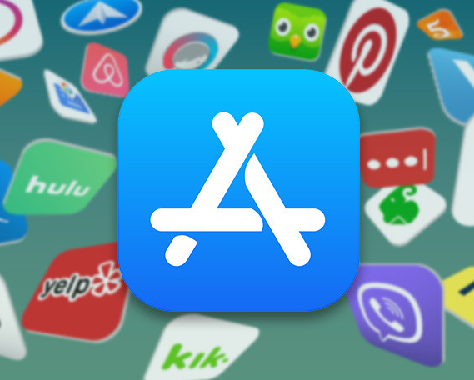
AGENDA
Project Purpose
Data Description
Key Assumptions
Findings & Recommendations
Next Steps
(Muchmore, 2019)

Slide 3

Project Purpose
What drives success for mobile applications?
Target Audience: Mobile application solutions firms
Assess characteristics of high user applications
Prospect industries to prioritize efforts
Gather insight on competitor analysis
Develop successful applications
(App Store, 2019)

Slide 4
DATA DESCRIPTION
The Mobile App Statistics dataset analysed contains more than 7000 Apple iOS mobile application details across 23 industry categories.
File size: 13 MB
Dimension of the data set: 7,197 rows, 16 columns
Collected on July 2017 from the iTunes Search API in the Apple Inc. website, utilizing R and linux web scraping tools (Ramanathan, 2017).
Fields used for this analysis: app category, price, number of screenshots for display in store, total ratings per app, ratings on recent version.
Also available were: average user rating, number of languages, group license, supported devices.
(Ramanathan, 2017)

Slide 5
KEY ASSUMPTIONS
Assumption #1: We used the differences in total number of ratings as a proxy for differences in the number of user downloads for each app category
Assumption #2: User ratings for the most recent version of the app are reflective of newer users to the app, and hence an indicator of app and user growth
(Ramanathan, 2017)

Slide 6
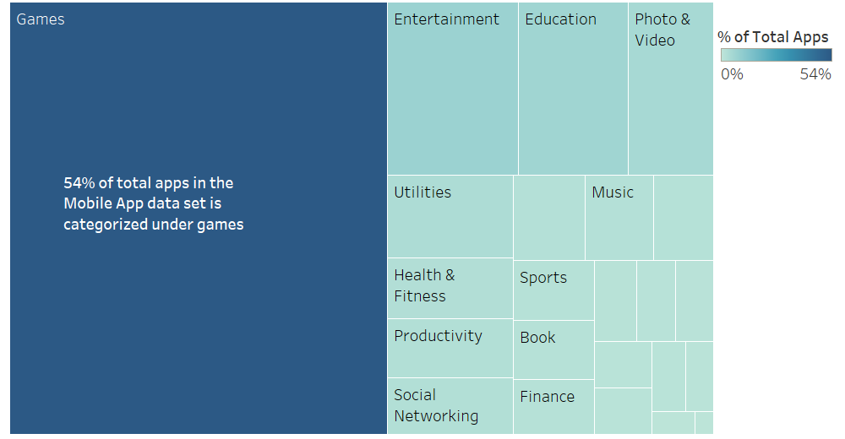
Categories
The Gaming category also sees the highest total number of ratings. This is, in part, driven by the sheer size of the category, containing the highest number of applications.
(Ramanathan, 2017)

Slide 7
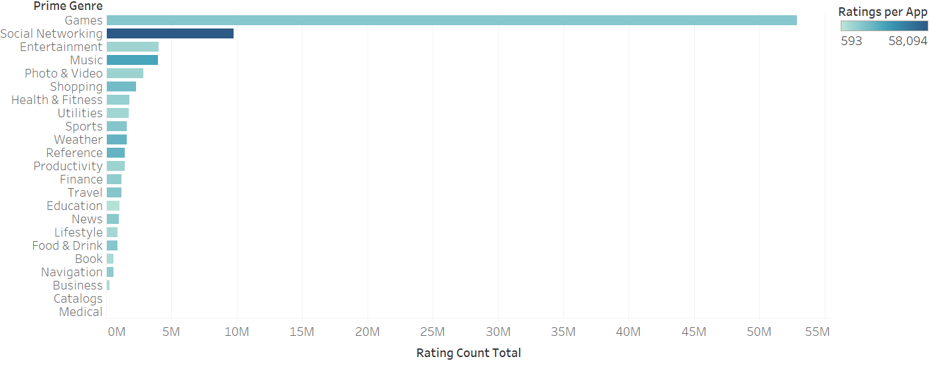

Categories
When accounting for the number of applications in each category, the most popular app categories driving the largest amount of users appear to be Social Networking, Music, Shopping, Weather and Reference.
(Ramanathan, 2017)

Slide 8
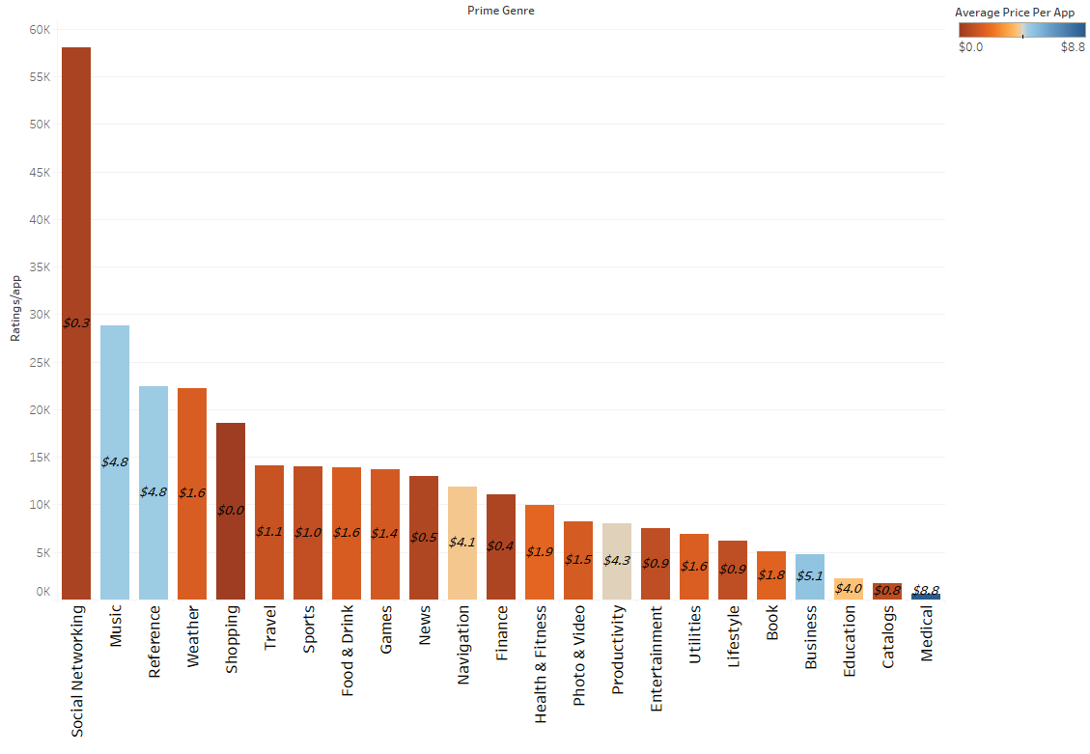
Number of app users by Price
Generally, lower priced apps clock in the most number of users. However, categories such Music and Reference have a high number of users despite being expensive, implying that customers are willing to pay a higher price for them.
Generally, apps that are priced lower clock in the most number of users.
However, certain categories such Music and Reference have a high number of users despite being expensive, implying that customers are willing to pay a higher price for them.
(Ramanathan, 2017)
(Ramanathan, 2017)

Slide 9
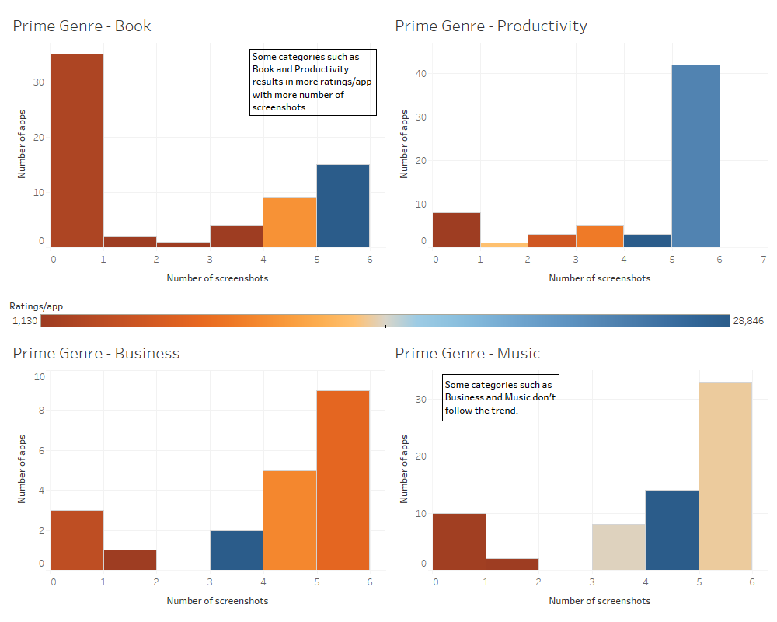
No. of Screenshots vs Ratings/App by Category
A higher number of screenshots (at least 3) appears to be generally associated with a larger number of users, particularly with genres like Books, Productivity, Music, though for need-based apps like Business it is less important.
(Ramanathan, 2017)

Slide 10
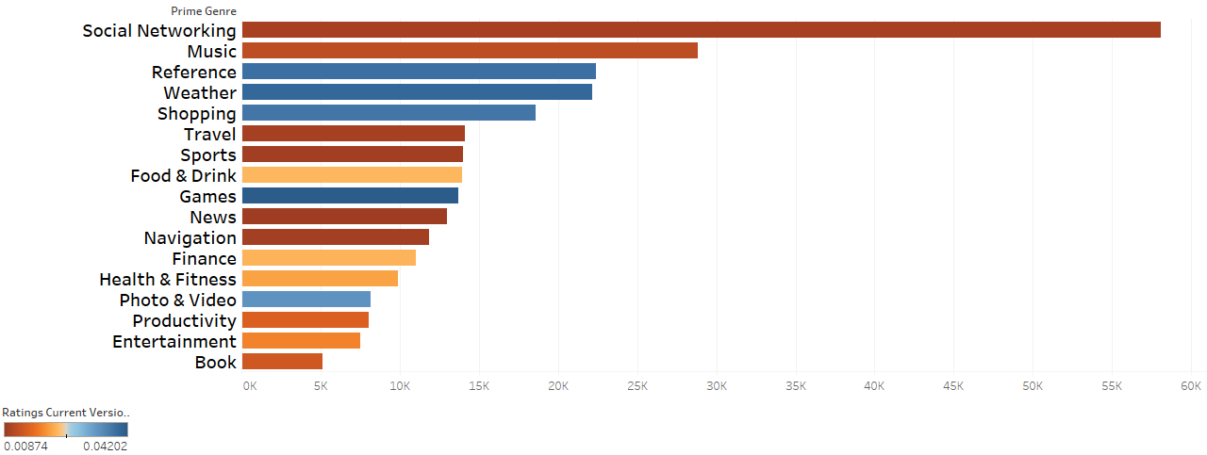
Gaming and Photo & Video should also be considered in the future as they are in growth mode, with the largest relative amount of rating for the most recent version
Number of Recent Version Ratings / Total Number of Ratings
(Ramanathan, 2017)
Three out of the top 5 app categories by ratings are also the highest growth apps, confirming they should be prioritized.
Note: Business, Catalog, Education, Utilities were left out, as they are relatively new and likely have one version only. A high ratio of recent ratings could indicate that Gaming and Photo & Video have the most relative number of new users OR the largest number of newer applications in the market - both an indication of active growth..

Slide 11
CONCLUSION
Consider prioritizing Social Media, Music, Weather, Reference and Shopping apps, as they typically get the most users and have the most monetary potential.
Consider pricing your app relatively low in the Social Media space, as most apps are either free of cost <$1 and an expensive Social Media app would have difficulty competing in the space. Music apps, along with need-based apps in the Business, Reference and Productivity space can be priced >$4.
Generally, at least 3 screenshots in the application’s description help drive more user downloads, though for categories like Business, Finance and Education it is less important.
Gaming and Photo & Video apps are growing - potential target in the future.

Slide 12
Q&A

Slide 13
References
Categories and Discoverability - App Store - Apple Developer. (2019). Retrieved from Apple Developer website: https://developer.apple.com/app-store/categories/
Glauninger, Silke (October, 2017). Why Ratings and Reviews Matter in App Store Optimization. Medium. Retrieved from: https://medium.com/app-radar-highlights/why-ratings-and-reviews-matter-in-app-store-optimization-5c93d285f029
Muchmore, Michael (July, 2019). The 100 Best iPhone Apps for 2019. PC Mag. Retrieved from: https://www.pcmag.com/article/286654/the-100-best-iphone-apps-for-2019
Ramanathan. (2017). Mobile App Store ( 7200 apps). Retrieved December 7, 2019, from Kaggle.com website: https://www.kaggle.com/ramamet4/app-store-apple-data-set-10k-apps/discussion
*Additional references can be found in the Mobile App Statistics (iOS App Store) report

